Slide 1
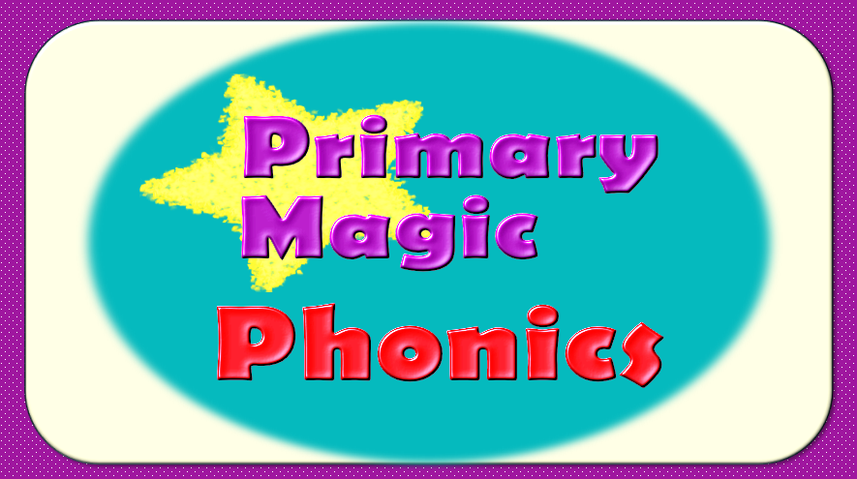

Slide 2
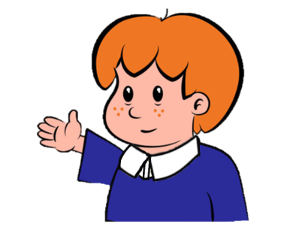

Welcome to
Primary Magic Phonics!
Today we are learning…
s
Welcome to
Primary Magic Phonics!
Today we are learning…
j

Slide 3
But first…
Can you say the phoneme for each of these graphemes?

Slide 4

h

Slide 5
ss

Slide 6
e

Slide 7
g

Slide 8
n

Slide 9
a

Slide 10
Now for today’s learning.
You will see the grapheme and hear the phoneme.
Are you ready?

Slide 11
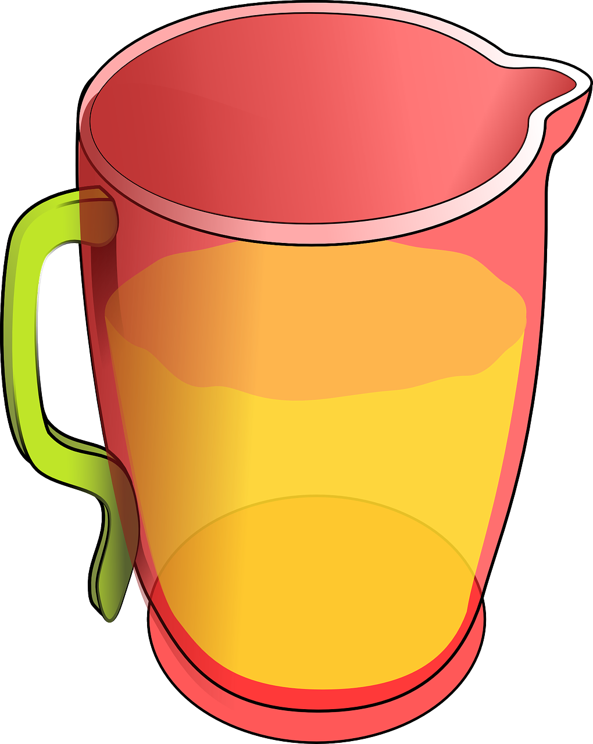
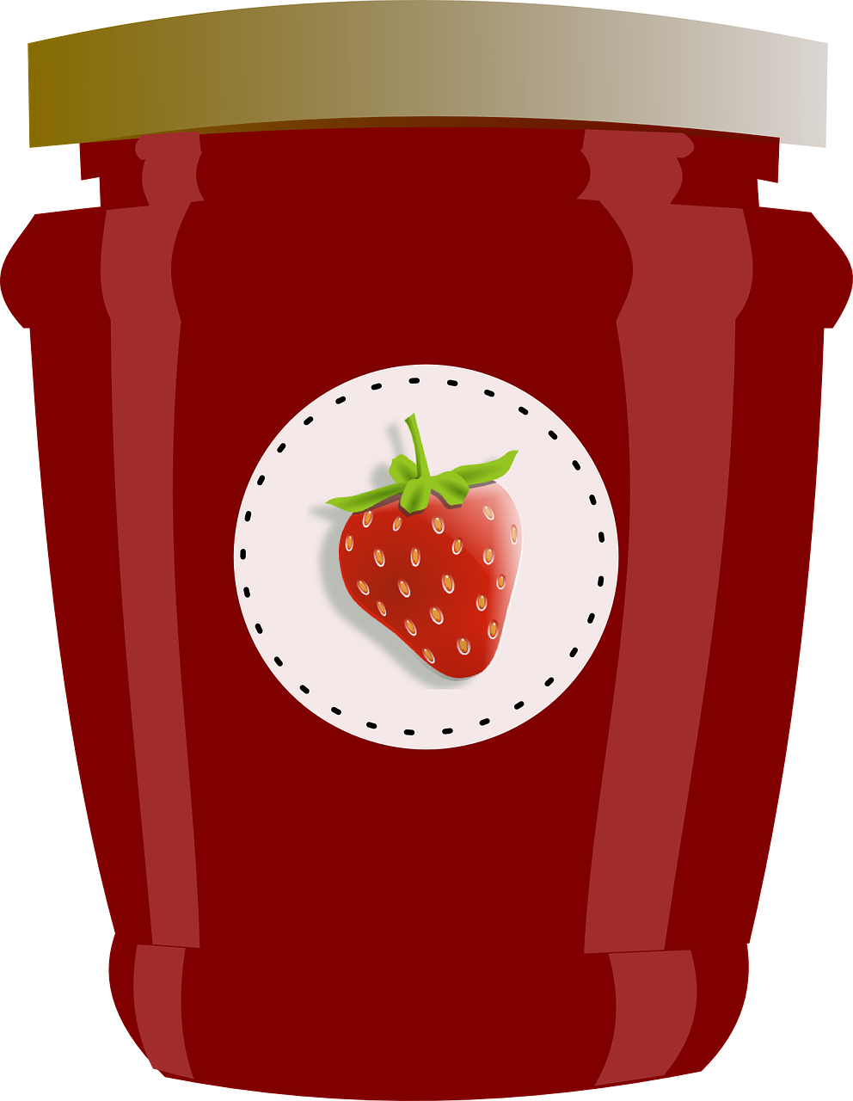


j

Slide 12
Can you read and spell these words?

Slide 13
j
a
m

Slide 14
j
a
m

Slide 15
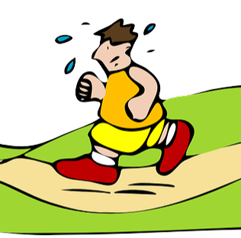
j
o
g

Slide 16
j
o
g

Slide 17
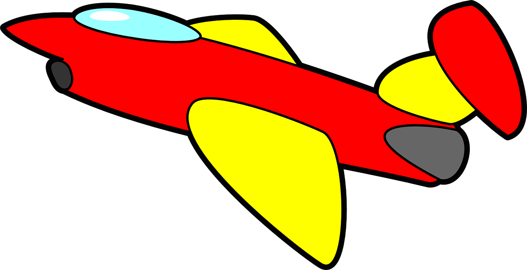
j
e
t

Slide 18
j
e
t

Slide 19
Can you read these words?

Slide 20
jot

Slide 21
jab

Slide 22
jig

Slide 23

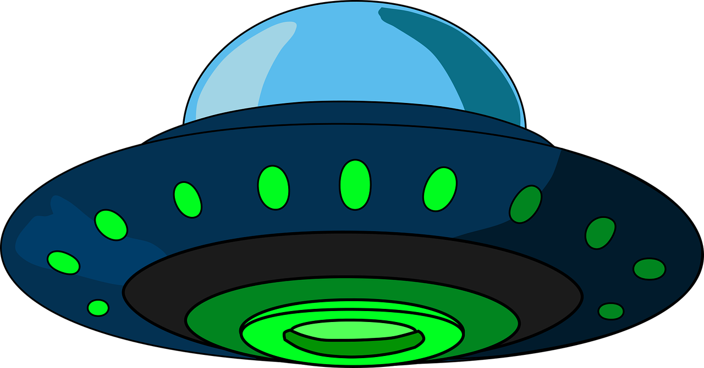
This is my friend Zog. He has lost all his words and he’s really worried. Can you help us sort the real words from the alien words?
Click if the word is real.
Click if the word is alien.

Slide 24

job
Real
Alien

Slide 25



Oh no!
?
Try again

Slide 26


job
Next
Real
Alien

Slide 27
jit
Real
Alien

Slide 28
Oh no!
?
Try again

Slide 29
jit
Next
Real
Alien

Slide 30
jug
Real
Alien

Slide 31
Oh no!
?
Try again

Slide 32
jug
Next
Real
Alien

Slide 33
jat
Real
Alien

Slide 34
Oh no!
?
Try again

Slide 35
jat
Next
Real
Alien

Slide 36
jep
Real
Alien

Slide 37
Oh no!
?
Try again

Slide 38
jep
Next
Real
Alien

Slide 39
jig
Real
Alien

Slide 40
Oh no!
?
Try again

Slide 41
jig
End game
Real
Alien

Slide 42
Good job!
Zog is very happy you have found all his words!

Slide 43

Now let’s spell some more real words. Can you write them?

Slide 44
jug

Slide 45
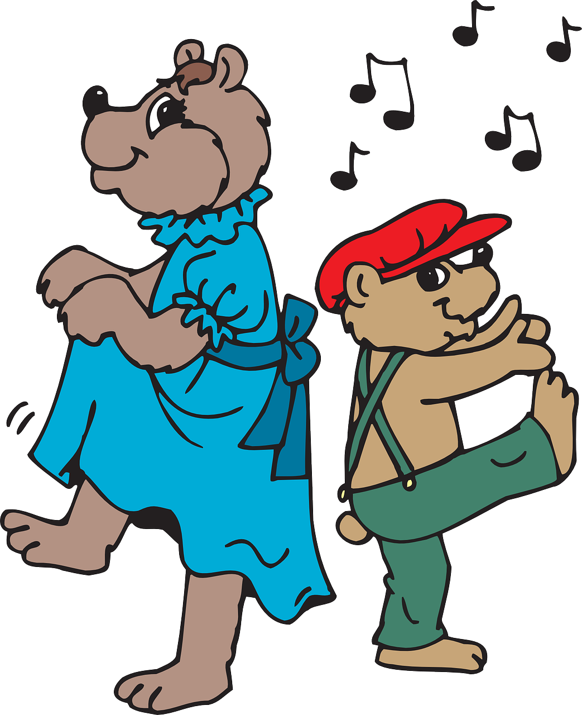
jig

Slide 46
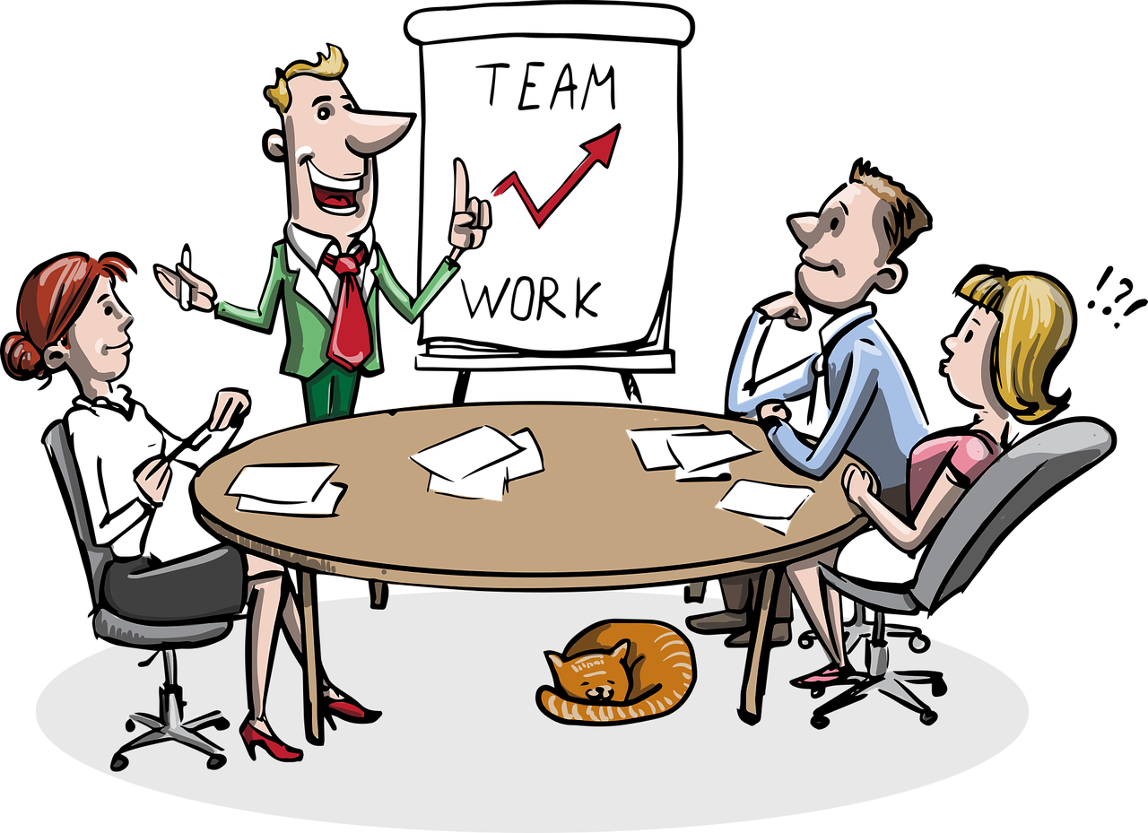
job

Slide 47
Can you read this sentence?

Slide 48
Jan and Jim like jam.

Slide 49
Can you write the sentence?

Slide 50
Jan and Jim like jam.

Slide 51

Fantastic work!

