Slide 1
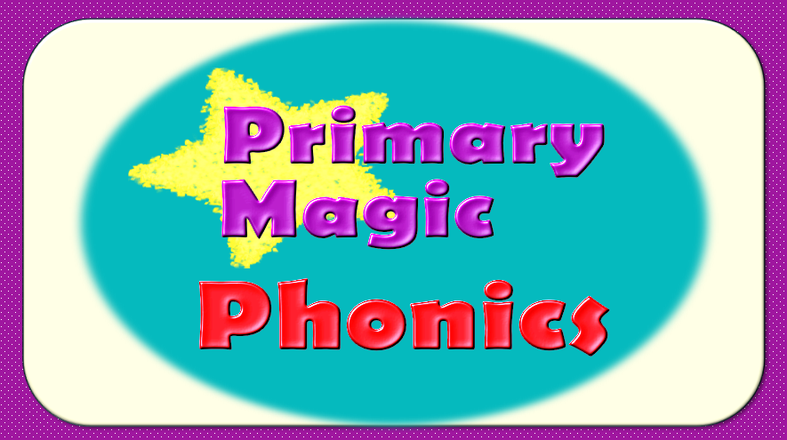

Slide 2
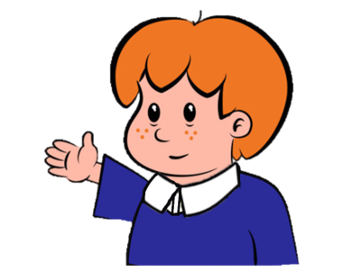

Welcome to
Primary Magic Phonics!
Today we are learning…
s
Welcome to
Primary Magic Phonics!
Today we are learning…
y

Slide 3
But first…
Can you say the phoneme for each of these graphemes?

Slide 4

s

Slide 5
m

Slide 6
k

Slide 7
r

Slide 8
x

Slide 9
w

Slide 10
Now for today’s learning.
You will see the grapheme and hear the phoneme.
Are you ready?

Slide 11
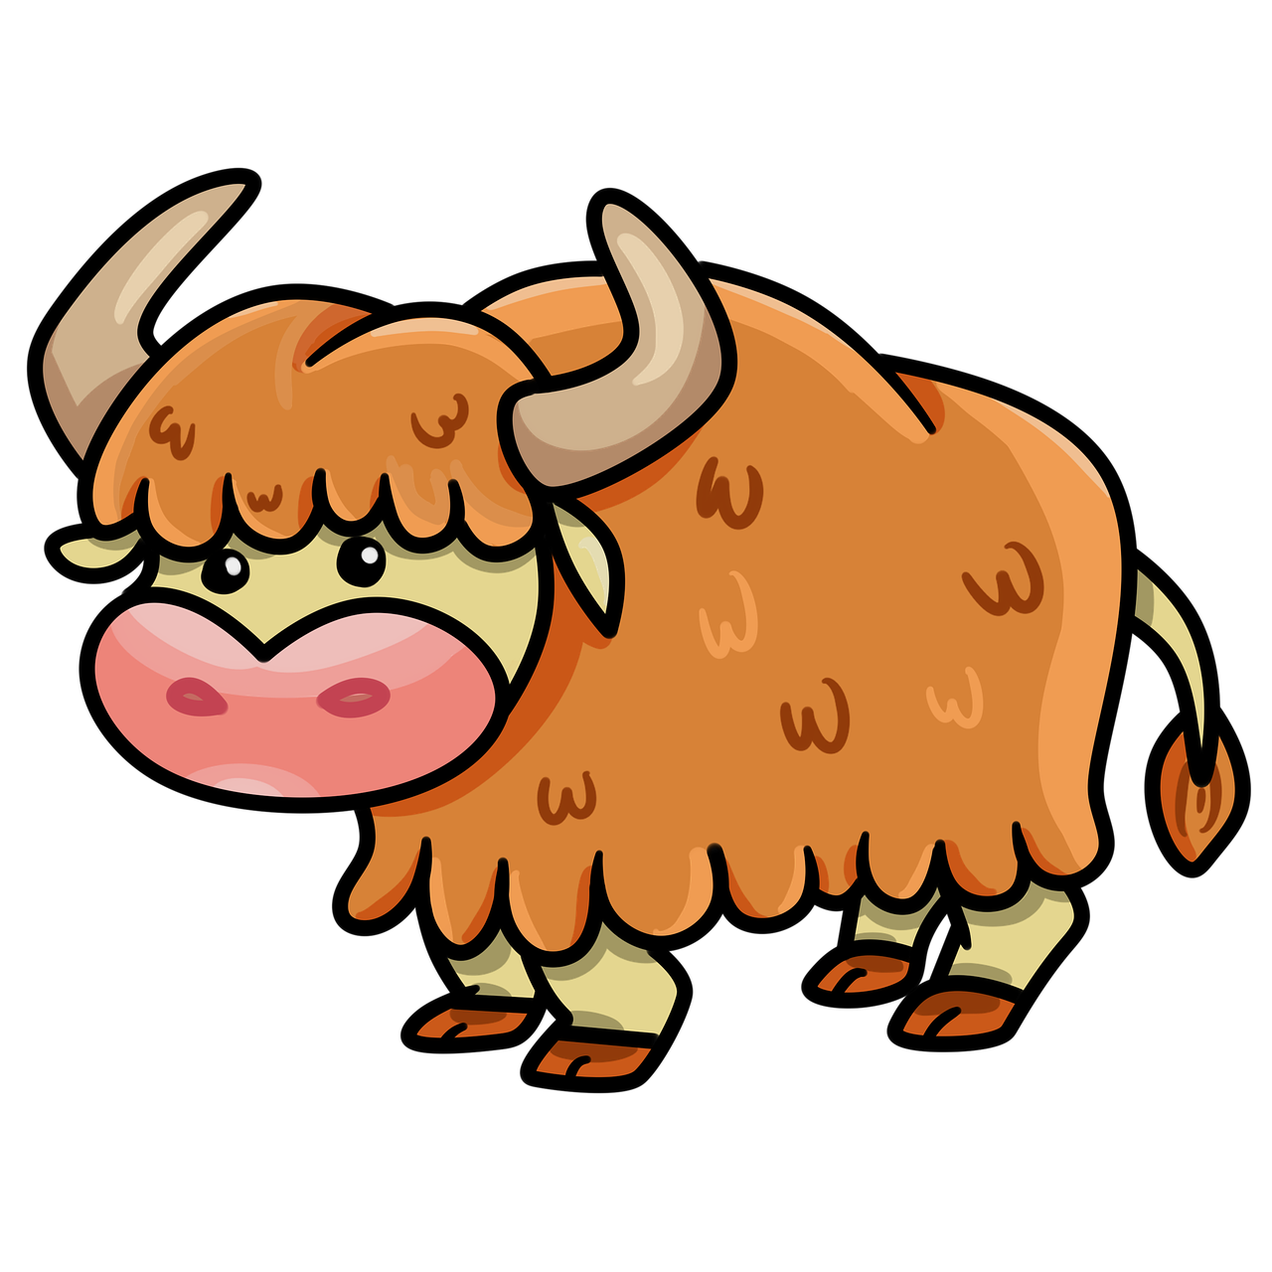

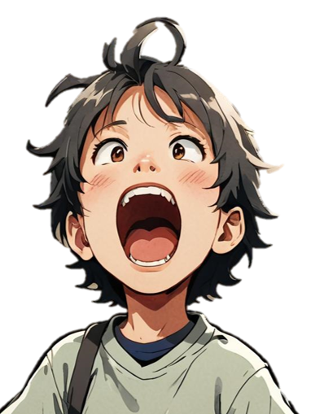
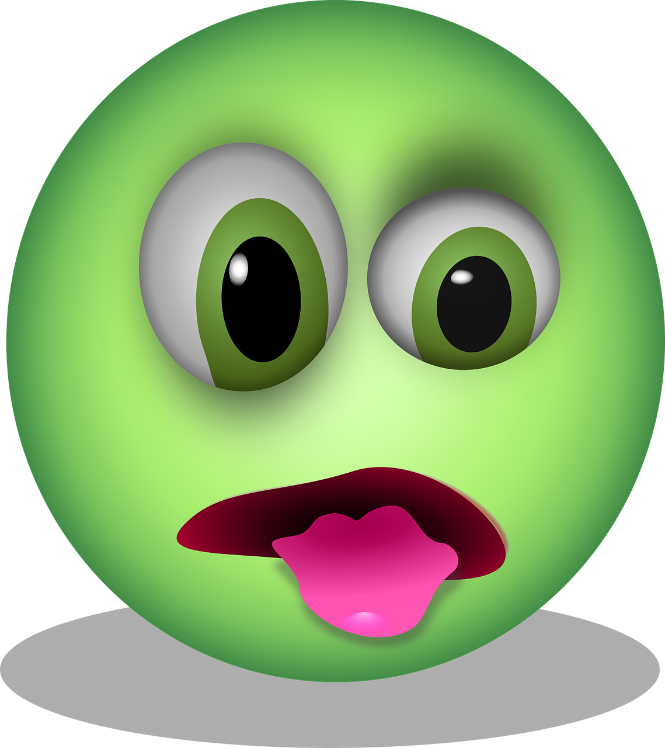
y

Slide 12
Can you read and spell these words?

Slide 13

y
u
m

Slide 14
y
u
m

Slide 15
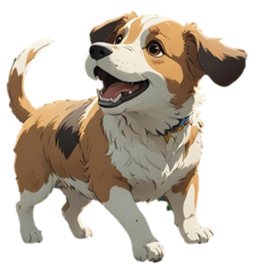
y
a
p

Slide 16
y
a
p

Slide 17
y
a
k

Slide 18
y
a
k

Slide 19
Can you read these words?

Slide 20
yet

Slide 21
yam

Slide 22
yip

Slide 23


This is my friend Zog. He has lost all his words and he’s really worried. Can you help us sort the real words from the alien words?
Click if the word is real.
Click if the word is alien.

Slide 24
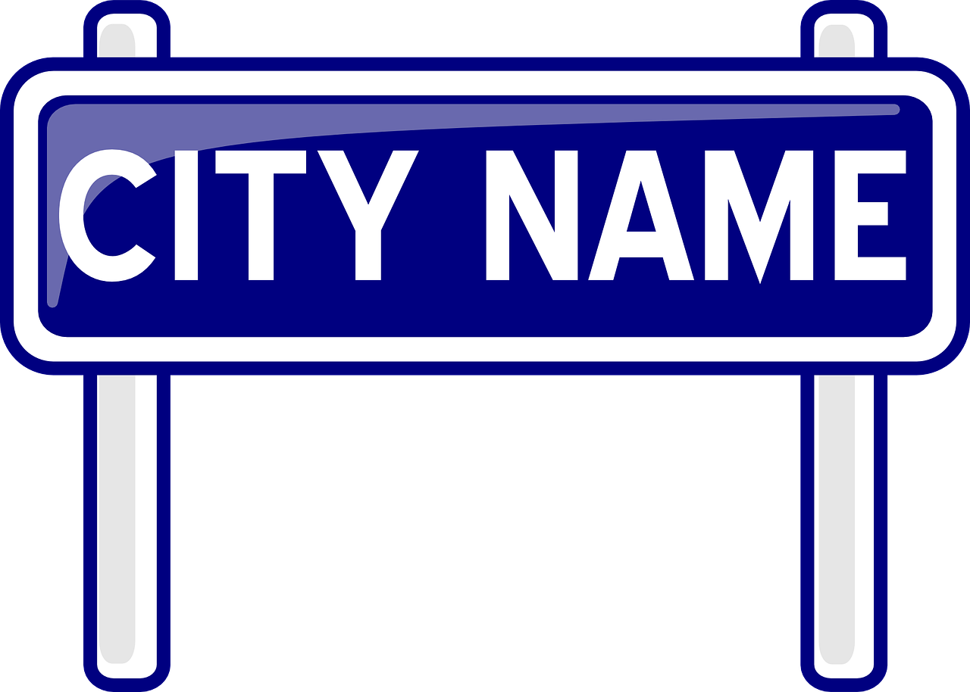
yap
Real
Alien

Slide 25



Oh no!
?
Try again

Slide 26


yap
Next
Real
Alien

Slide 27
yad
Real
Alien

Slide 28
Oh no!
?
Try again

Slide 29
yad
Next
Real
Alien

Slide 30
yet
Real
Alien

Slide 31
Oh no!
?
Try again

Slide 32
yet
Next
Real
Alien

Slide 33
yeff
Real
Alien

Slide 34
Oh no!
?
Try again

Slide 35
yeff
Next
Real
Alien

Slide 36
yop
Real
Alien

Slide 37
Oh no!
?
Try again

Slide 38
yop
Next
Real
Alien

Slide 39
yum
Real
Alien

Slide 40
Oh no!
?
Try again

Slide 41
yum
End game
Real
Alien

Slide 42
Good job!
Zog is very happy you have found all his words!

Slide 43

Now let’s spell some more real words. Can you write them?

Slide 44
yes

Slide 45
yell

Slide 46
yuck

Slide 47
Can you read this sentence?

Slide 48
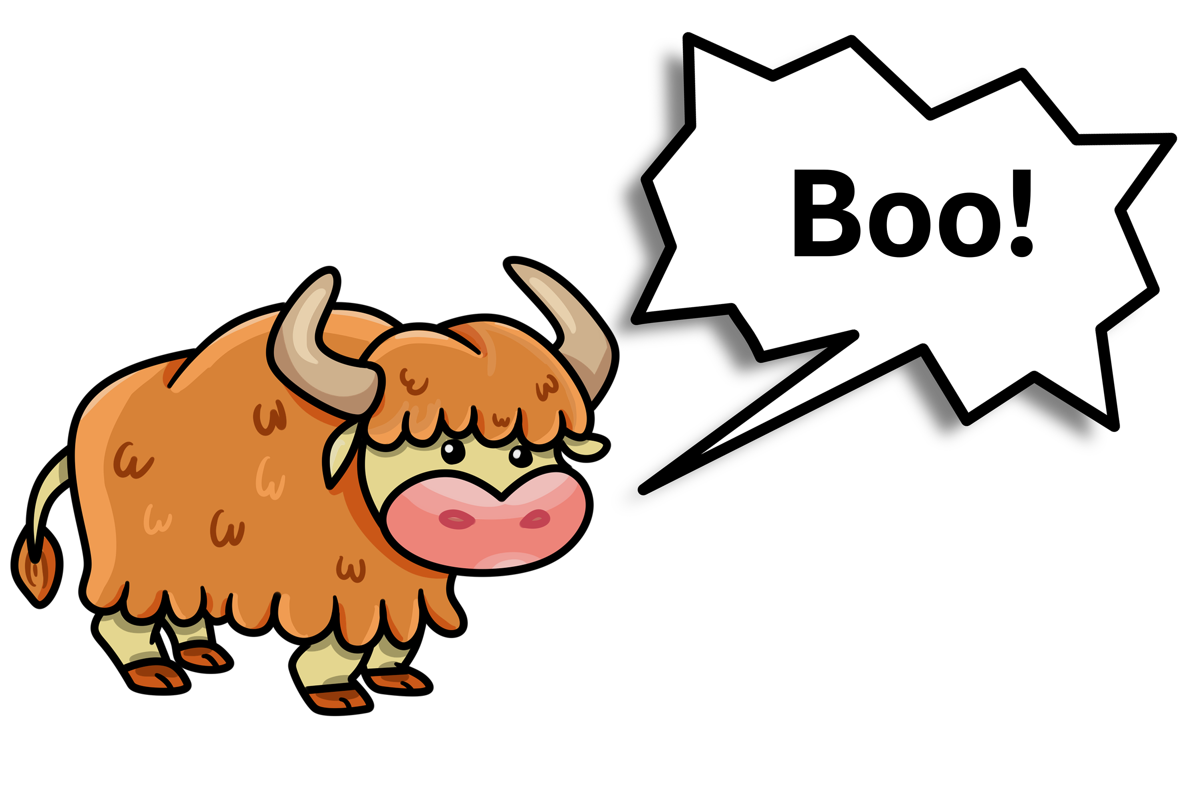
Yes, a yak can yell.

Slide 49
Can you write the sentence?

Slide 50
Yes, a yak can yell.

Slide 51

Fantastic work!

