Slide 1


Slide 2
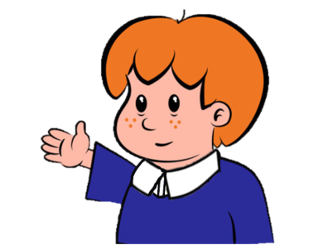

Welcome to
Primary Magic Phonics!
Today we are learning…
s
Welcome to
Primary Magic Phonics!
Today we are learning…
s

Slide 3
But first…
What’s in the box?
Listen carefully!

Slide 4

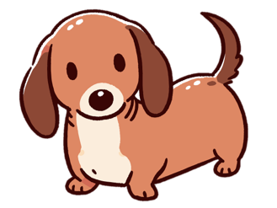


Slide 5
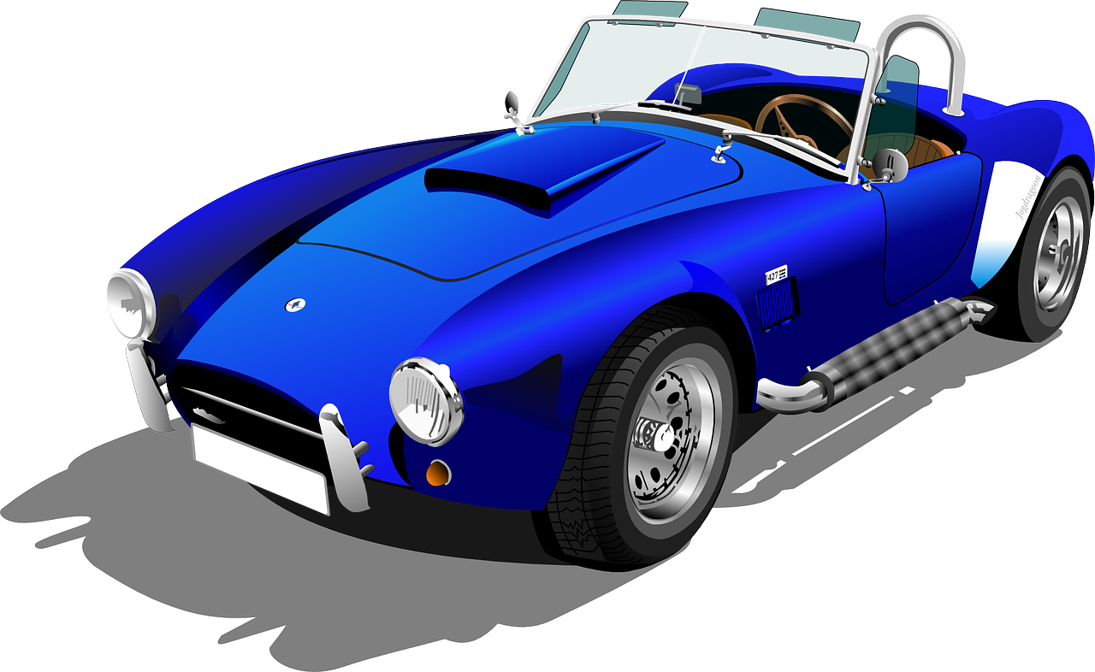

Slide 6
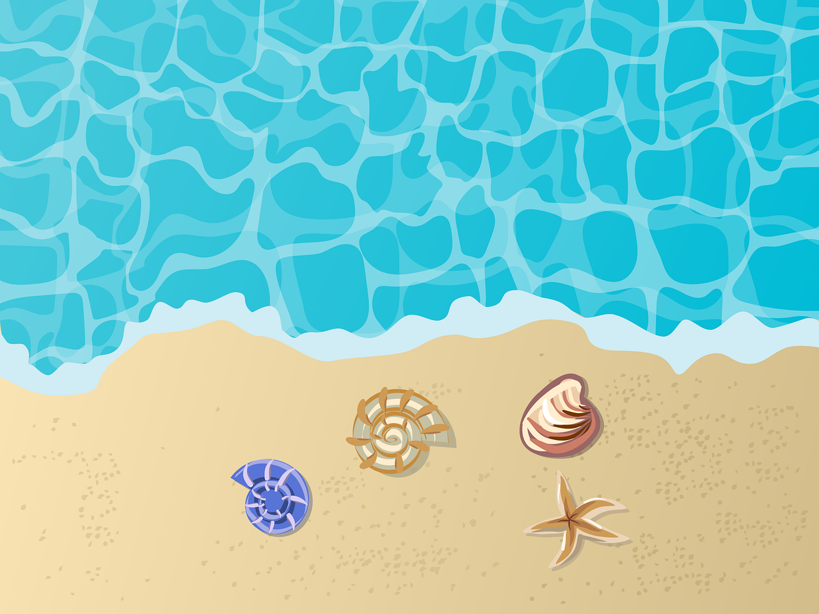

Slide 7
Now for today’s learning.
You will see the grapheme and hear the phoneme.
Are you ready?

Slide 8
s

Slide 9
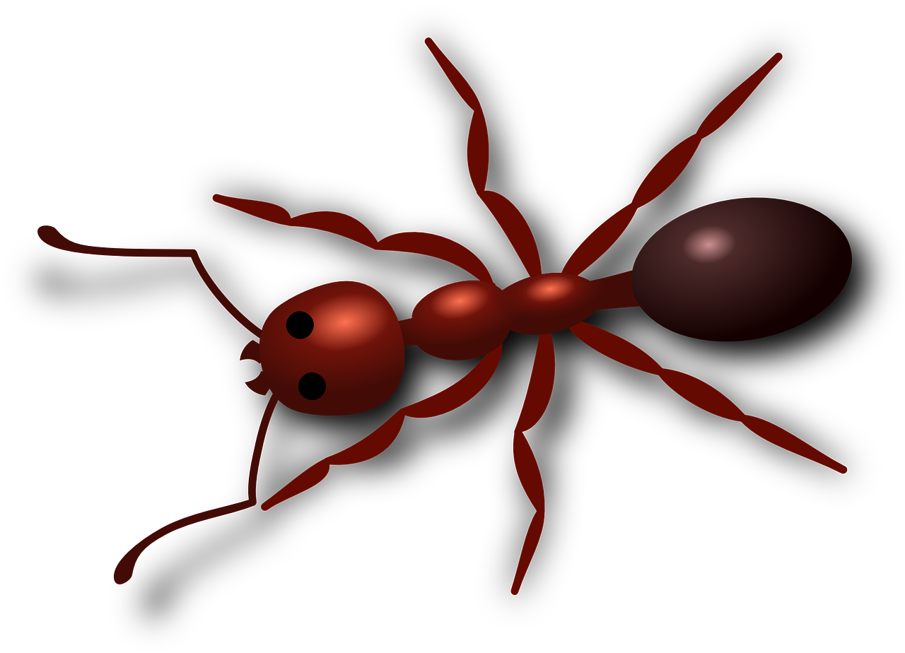




Click on the picture that begins with
s

Slide 10



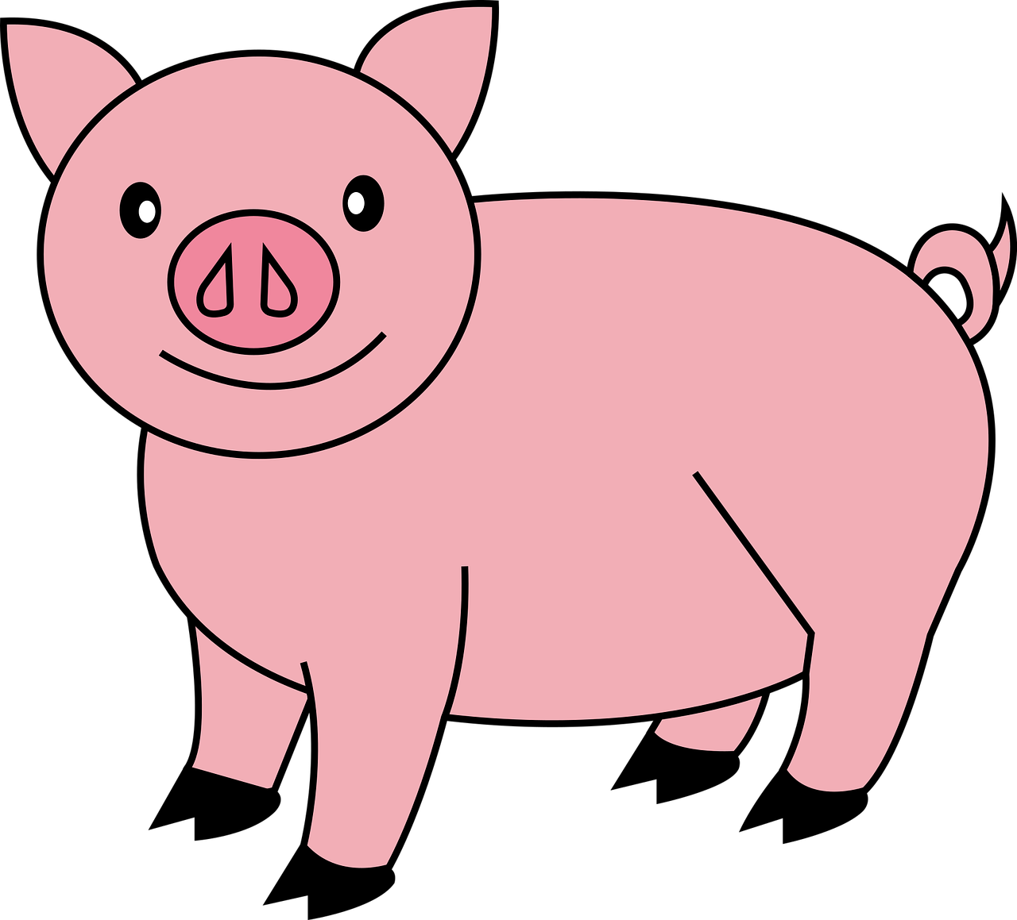

Click on the picture that begins with
s

Slide 11

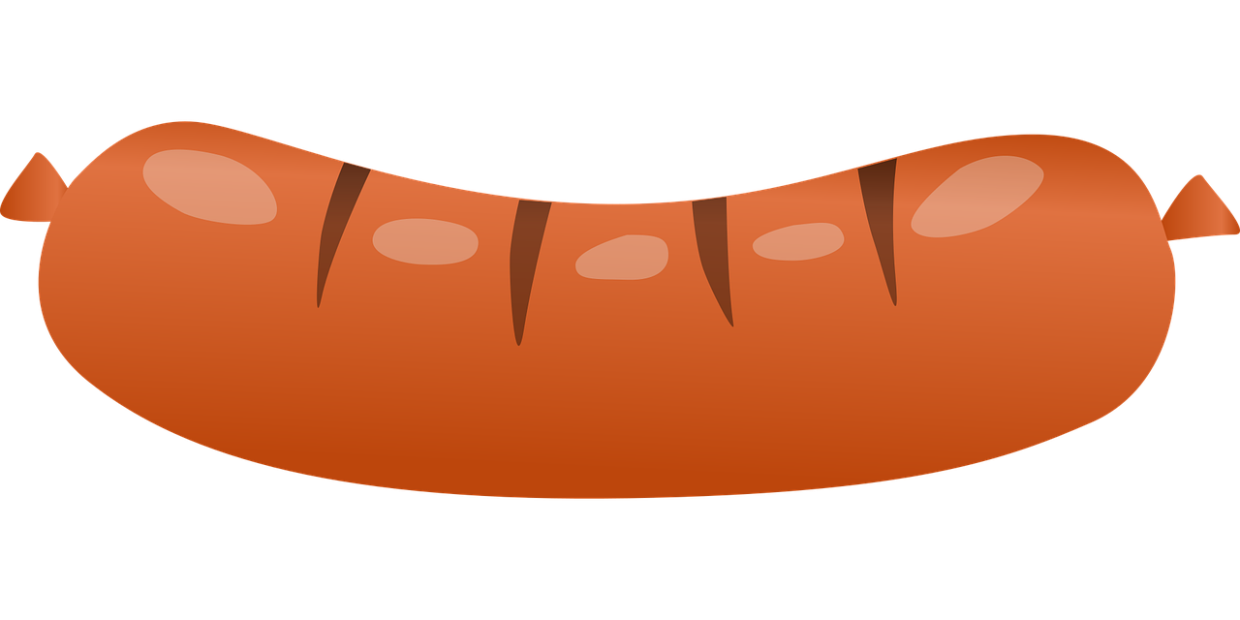


Click on the picture that begins with
s

Slide 12
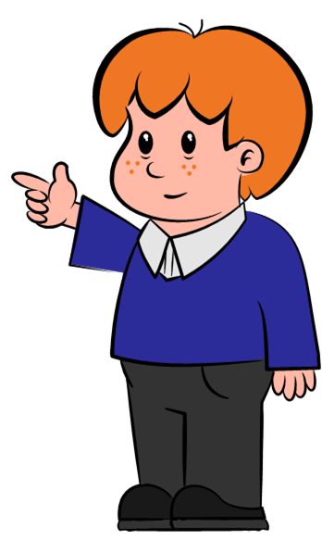
Can you write ‘s’ in the air?

Slide 13
s

Slide 14

Can you write ‘s’ on your whiteboard?

Slide 15
s

Slide 16
Can you hear ‘s’ in this story? Thumbs up every time you hear ‘s’.

Slide 17

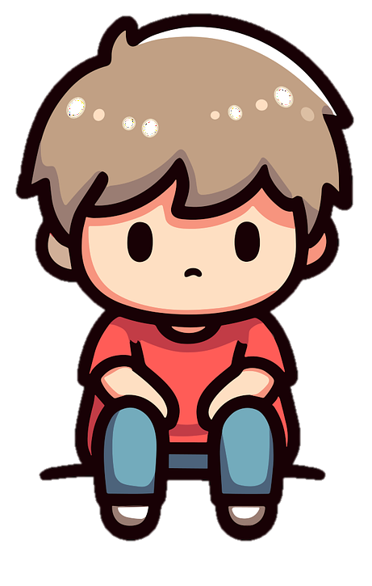
Sam is sad. He sat on the sand and got sand in his socks. Silly Sam! Don’t sit on the sand, sit over here in the sun.

Slide 18

Fantastic work!

