Slide 1
www.primarymagic.co.uk

Slide 2
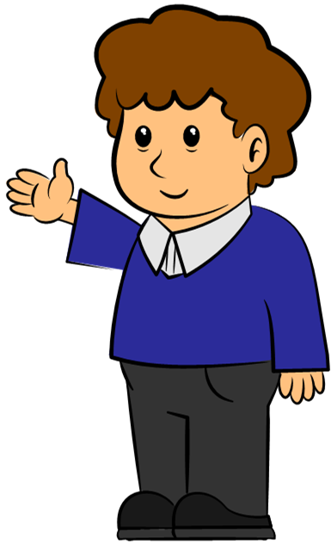
Welcome to
Primary Magic Phonics!
Today we are learning…
s
Welcome to
Primary Magic Grammar!
Today we are learning about nouns.

Slide 3
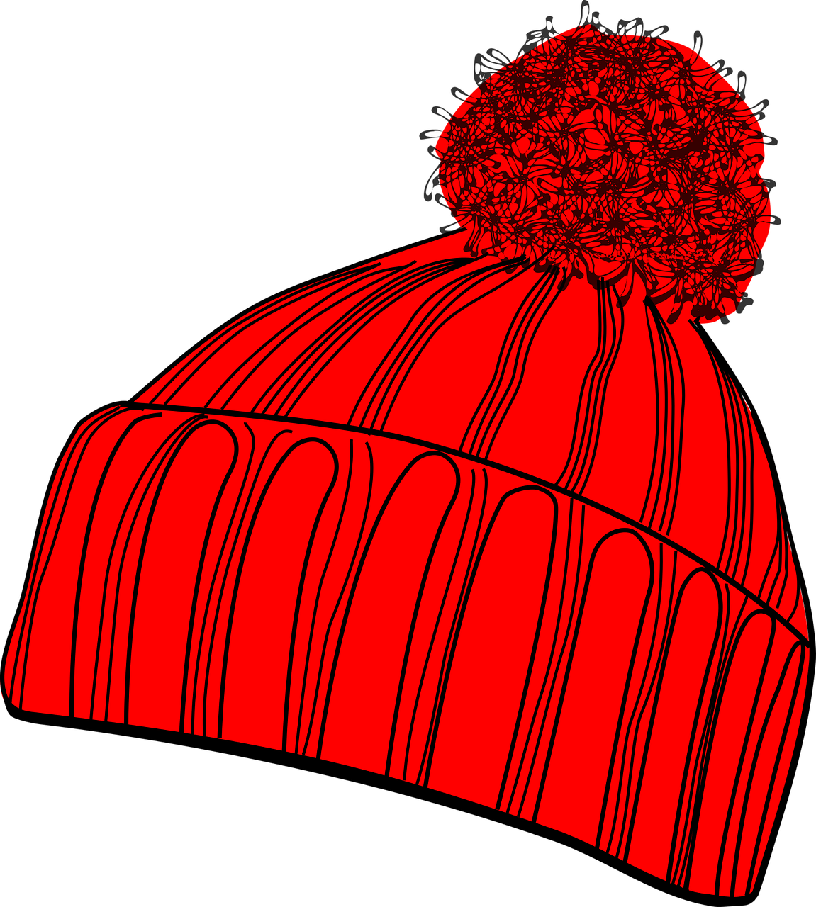
What is this?
Welcome to
Primary Magic Phonics!
Today we are learning…
s
Noun
A hat.
A hat.

Slide 4
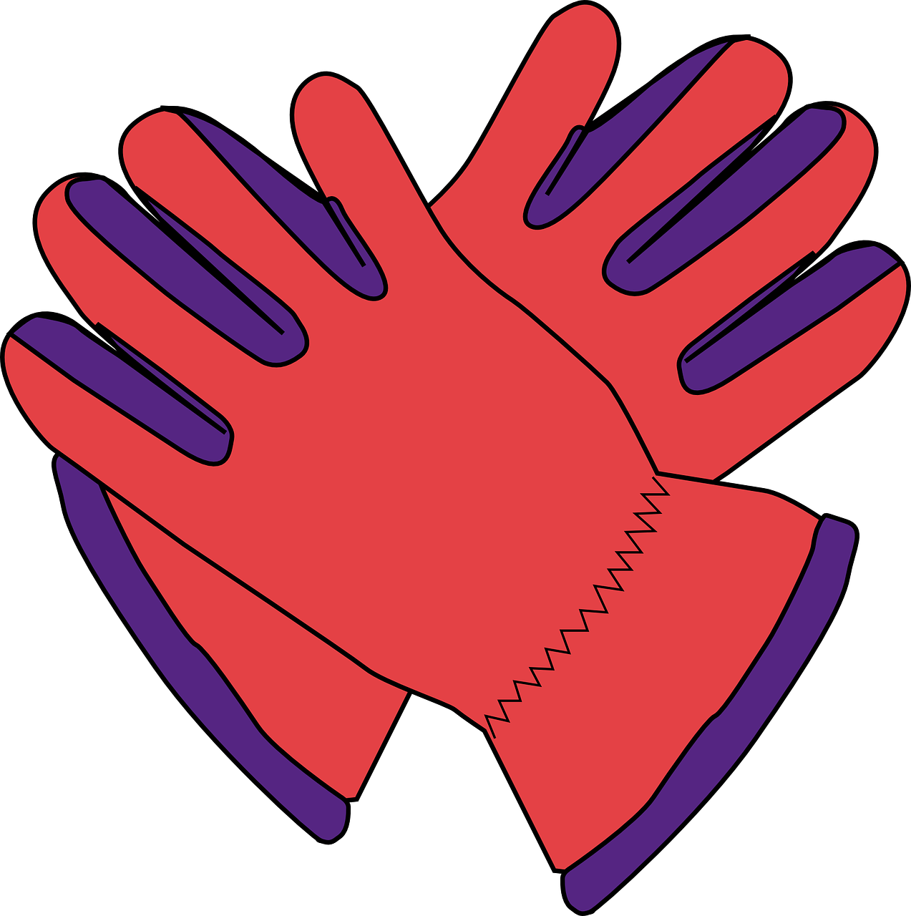
What is this?
Welcome to
Primary Magic Phonics!
Today we are learning…
s
Noun
Some gloves.
Some gloves.

Slide 5
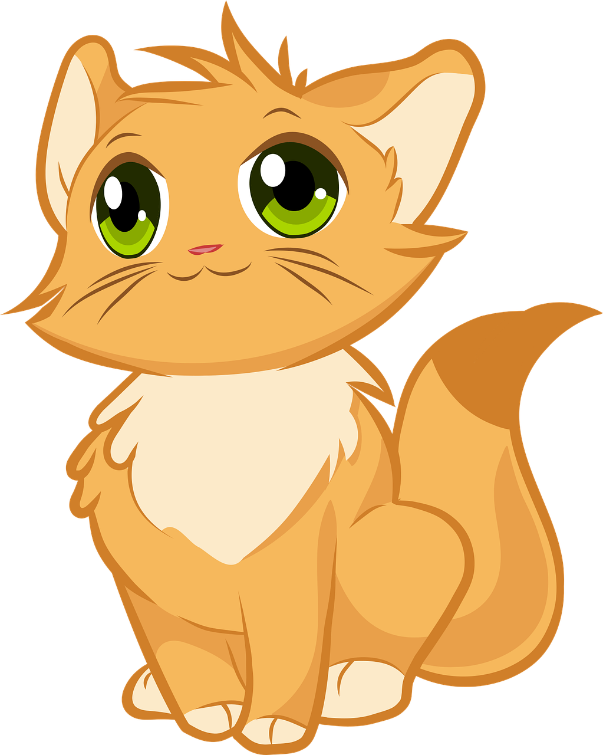
What is this?
Welcome to
Primary Magic Phonics!
Today we are learning…
s
Noun
A cat.
A cat.

Slide 6
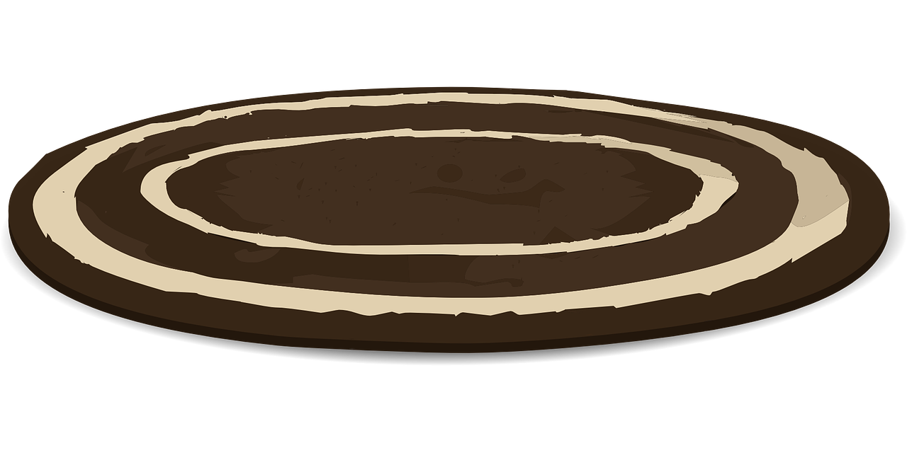
Which words are nouns?
Welcome to
Primary Magic Phonics!
Today we are learning…
s
Noun
The cat sat on the mat.
___
____
Noun

Slide 7
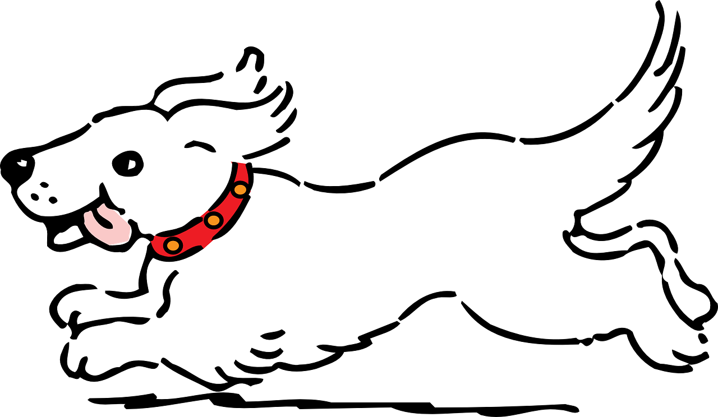
Which words are nouns?
Welcome to
Primary Magic Phonics!
Today we are learning…
s
Noun
___
___
The dog chased the ball.
Noun

Slide 8
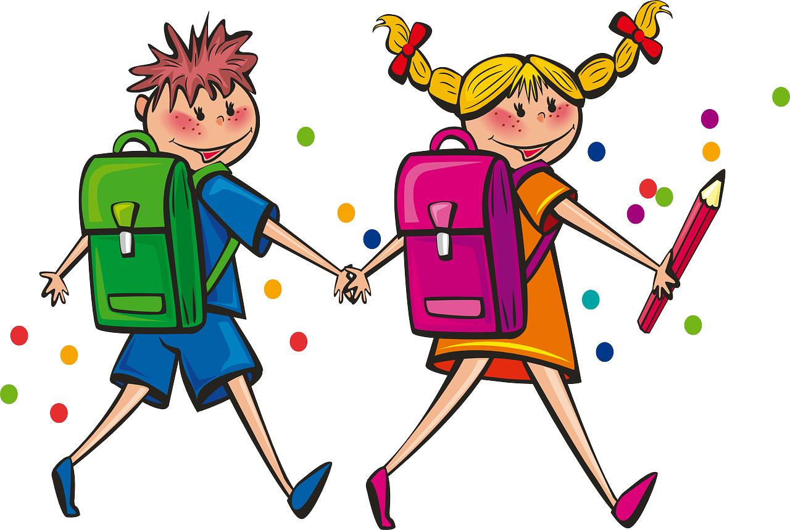
Which words are nouns?
Welcome to
Primary Magic Phonics!
Today we are learning…
s
Noun
_______
The children went to school.
_____
Noun

Slide 9
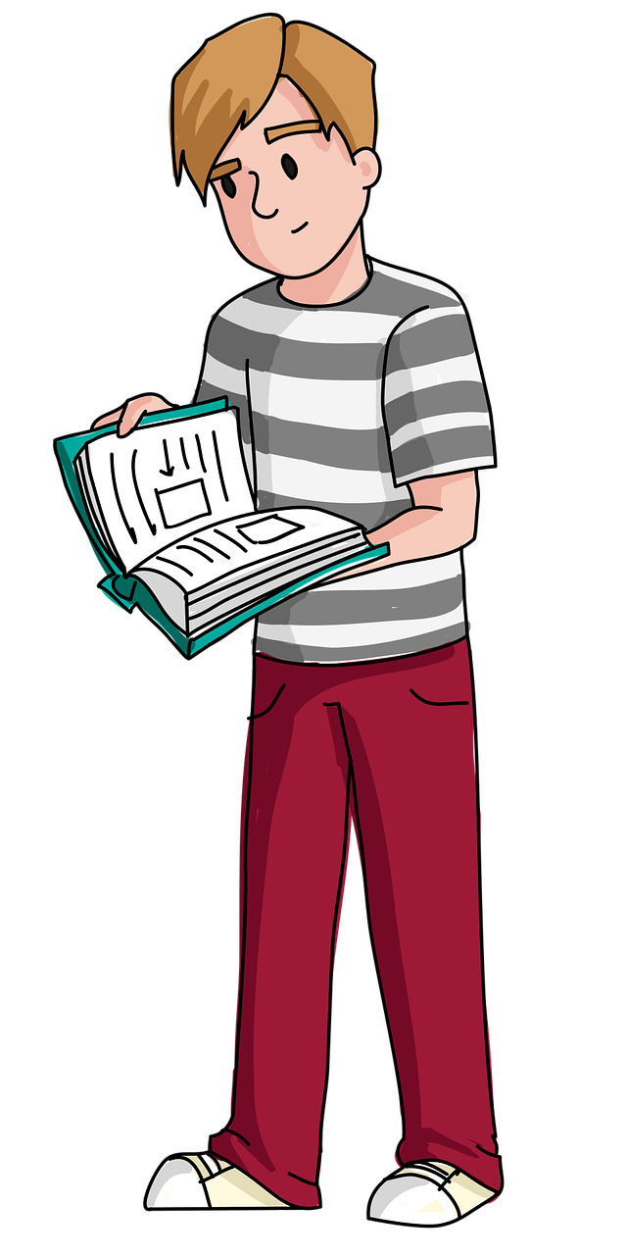
Which words are nouns?
Welcome to
Primary Magic Phonics!
Today we are learning…
s
Noun
The boy read a book.
___
____
Noun

Slide 10
Welcome to
Primary Magic Phonics!
Today we are learning…
s
Can you think of a noun that these words can describe?
big
small
pink
round
silly

Slide 11
Well done!

Slide 12
www.primarymagic.co.uk

