Slide 2
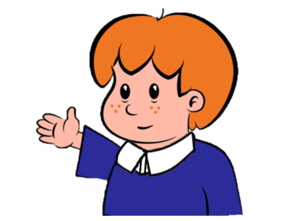
Welcome to
Primary Magic Phonics!
Today we are learning…
s
Welcome to
Primary Magic Phonics!
Today we are learning…
h

Slide 3
But first…
Can you say the phoneme for each of these graphemes?

Slide 4
d

Slide 5
i

Slide 6
m

Slide 7
r

Slide 8
u

Slide 9
c

Slide 10
Now for today’s learning.
You will see the grapheme and hear the phoneme.
Are you ready?

Slide 11
h

Slide 12
Which word begins with h?

Slide 13
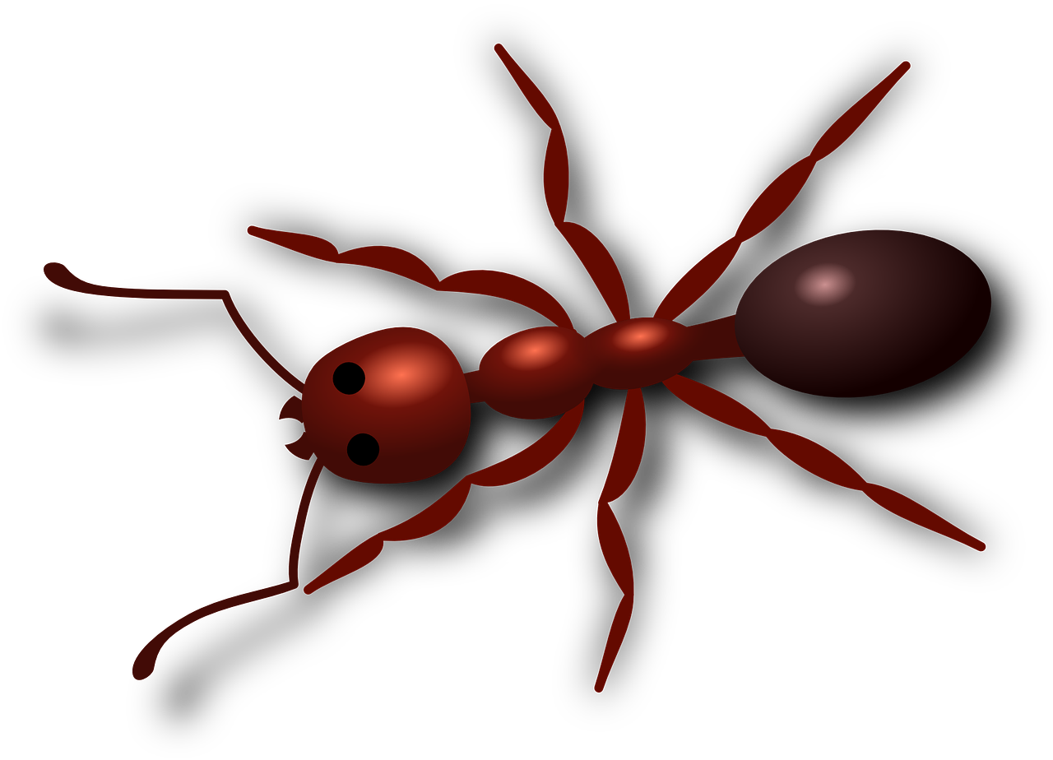
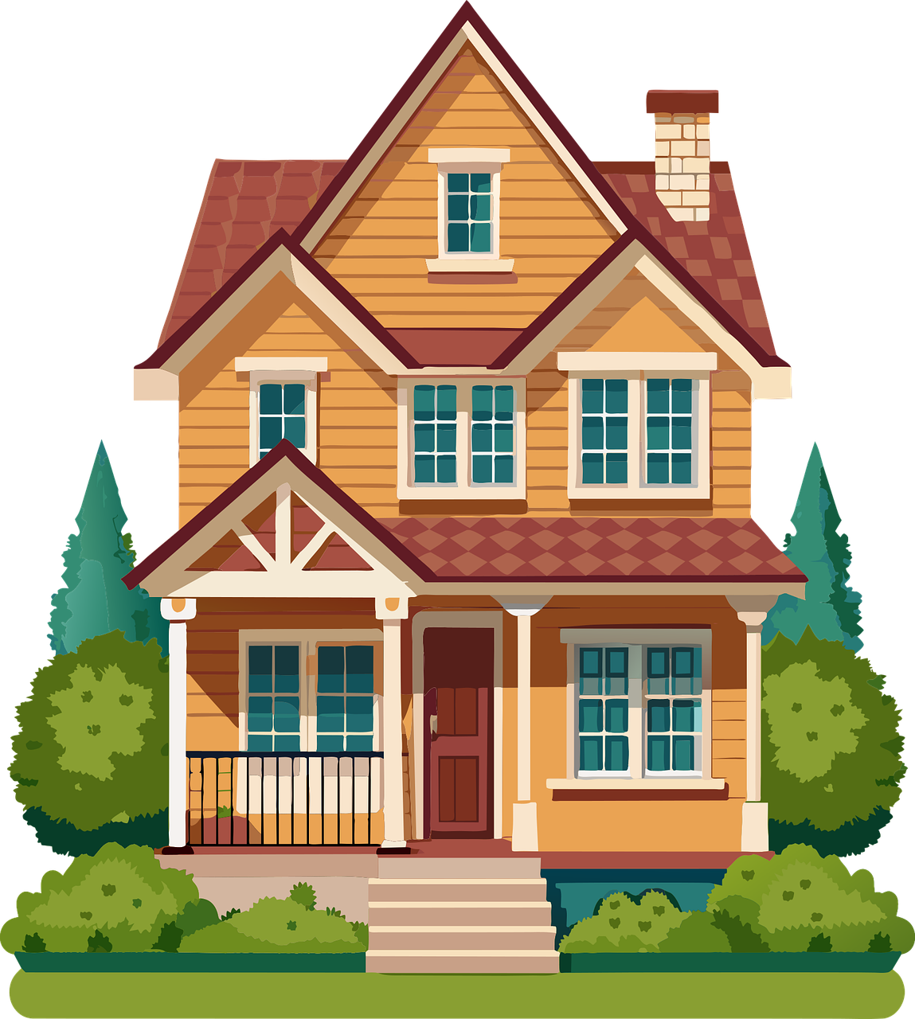
Click on the picture that begins with
h

Slide 14
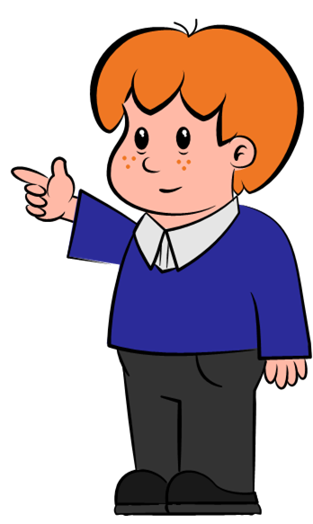
Can you write h in the air?

Slide 15
h

Slide 16
Can you write h on your whiteboard?

Slide 17
h

Slide 18
Can you read and spell these words?

Slide 19
h
a
t

Slide 20
h
a
t

Slide 21
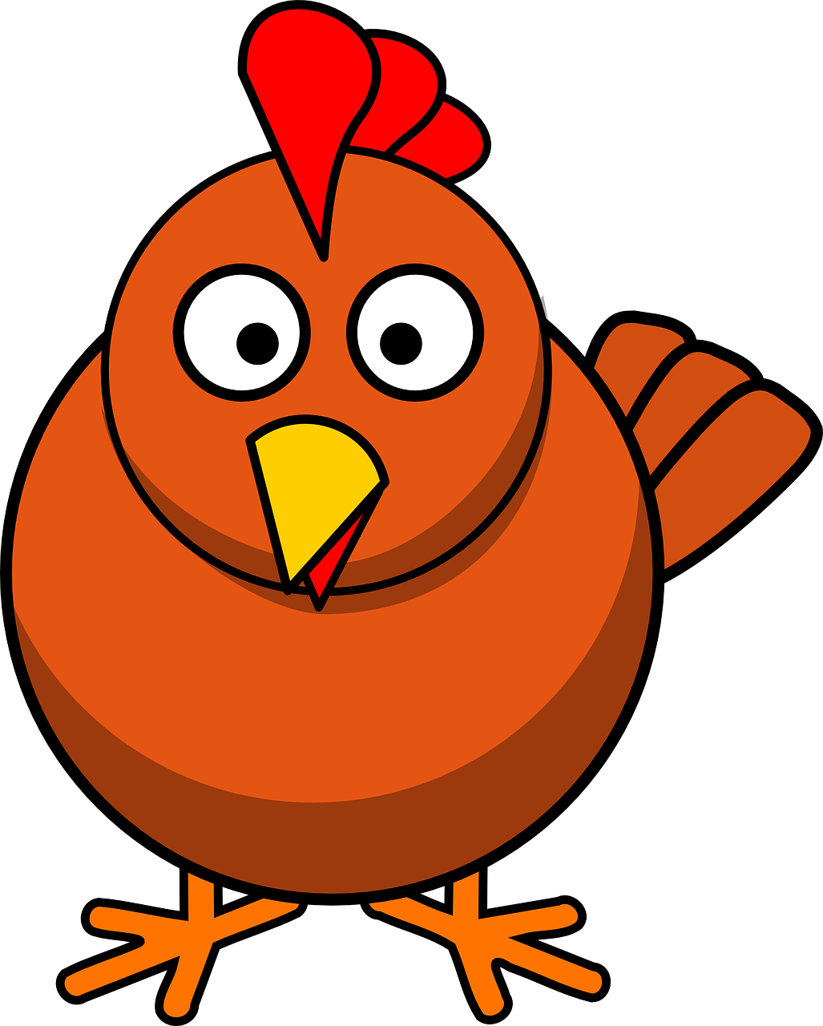
h
e
n

Slide 22
h
e
n

Slide 23
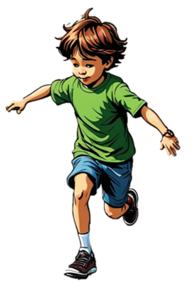
h
o
p

Slide 24
h
o
p

Slide 25
Time for a silly question! Is the answer yes or no?

Slide 26
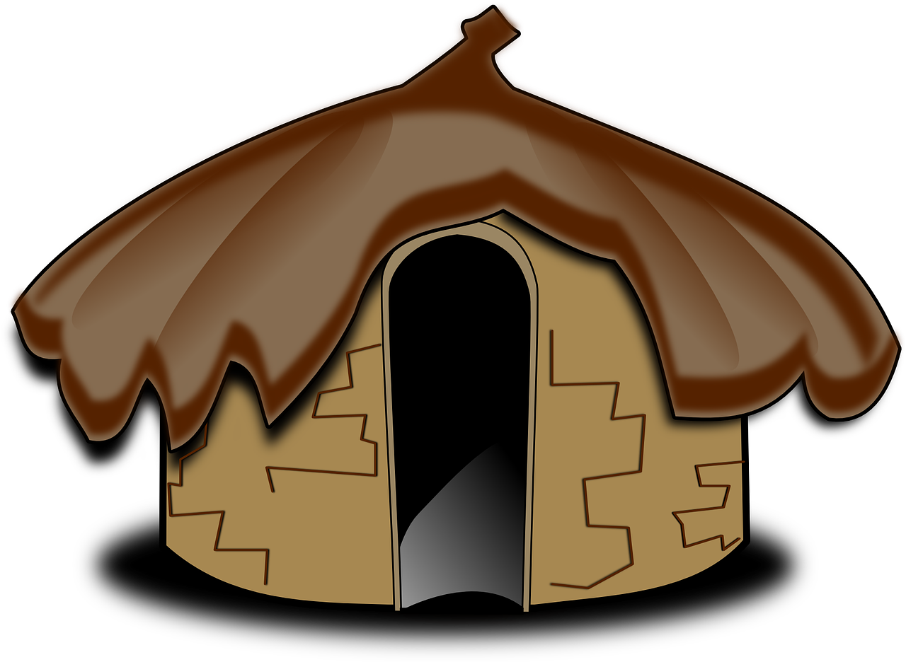
Can a hut hop?
yes
no

Slide 27
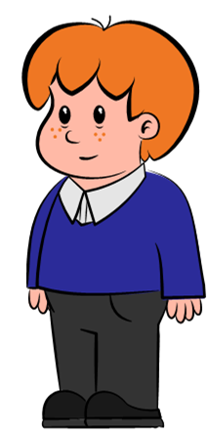
Try again

Slide 28
Fantastic work!

